Slide 1
Loops and Iteration (Part 1)
Chapter 5
Notes:
Note from Chuck. If you are using these materials, you can remove the UM logo and replace it with your own, but please retain the CC-BY logo on the first page as well as retain the acknowledgement page(s) at the end.

Slide 2
Why Loops?
1. Automation of Repetitive Tasks
2. Efficient Data Processing
3. Dynamic Control of Execution
4. Reducing Code Redundancy and Improving Readability
5. Handling Unknown or Large Data Sets

Slide 3
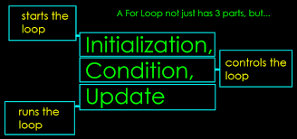
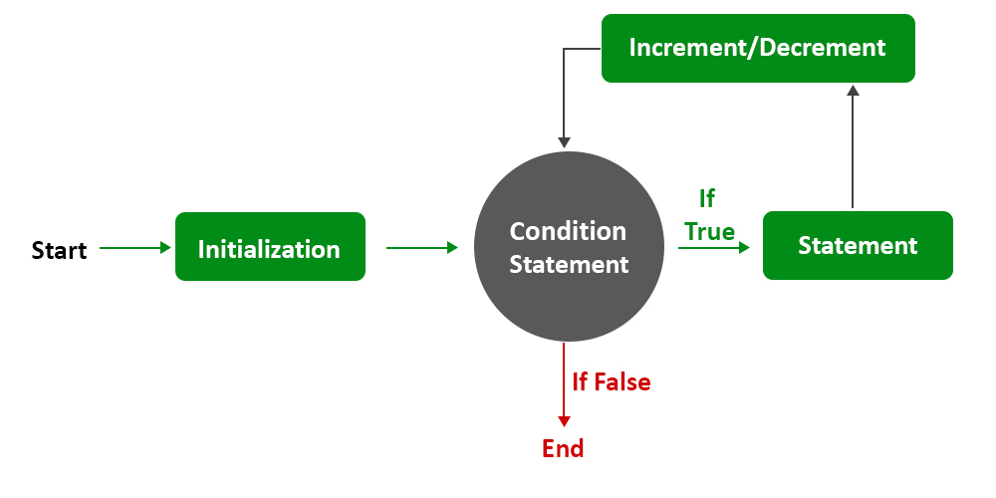
Types of loops and Important parts
1. while
2. for
3. do-while

Slide 4
Repeated Steps
n = 0
Program:
n = 0
while n < 5 :
print(n)
n = n + 1
print('Blastoff!')
print(n)
Output:
0
1
2
3
4
Blastoff!
5
No
n < 5 ?
Yes
print(n)
n = n +1
Loops (repeated steps) have iteration variables that change each time through a loop. Often these iteration variables go through a sequence of numbers.
print('Blastoff')

Slide 5
Repeated Steps
n = 5
Program:
n = 5
while n > 0 :
print(n)
n = n – 1
print('Blastoff!')
print(n)
Output:
5
4
3
2
1
Blastoff!
0
No
n > 0 ?
Yes
print(n)
n = n -1
Loops (repeated steps) have iteration variables that change each time through a loop. Often these iteration variables go through a sequence of numbers.
print('Blastoff')

Slide 6
An Infinite Loop
n = 5
No
n > 0 ?
Yes
n = 5
while n > 0 :
print('Lather')
print('Rinse')
print('Dry off!')
print('Lather')
print('Rinse')
print('Dry off!')
What is wrong with this loop?

Slide 7
Another Loop
n = 0
No
n > 0 ?
Yes
n = 0
while n > 0 :
print('Lather')
print('Rinse')
print('Dry off!')
print('Lather')
print('Rinse')
print('Dry off!')
What is this loop doing?

Slide 8
Exercise 1
Write a program to:
1. print numbers from 15 to 30
2. sum first n natural numbers
3. print even numbers from 1 to 20
4. find the factorial of a number
5. print a multiplication table of a number up to 10
6. reverse a list
7. sum of digits in a number
8. find the maximum in a list

Slide 9
Breaking Out of a Loop
The break statement ends the current loop and jumps to the statement immediately following the loop
It is like a loop test that can happen anywhere in the body of the loop
while True:
line = input('> ')
if line == 'done' :
break
print(line)
print('Done!')
> hello there
hello there
> finished
finished
> done
Done!

Slide 10
Breaking Out of a Loop
The break statement ends the current loop and jumps to the statement immediately following the loop
It is like a loop test that can happen anywhere in the body of the loop
while True:
line = input('> ')
if line == 'done' :
break
print(line)
print('Done!')
> hello there
hello there
> finished
finished
> done
Done!

Slide 11
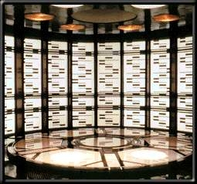
No
True ?
Yes
while True:
line = input('> ')
if line == 'done' :
break
print(line)
print('Done!')
....
break
...
http://en.wikipedia.org/wiki/Transporter_(Star_Trek)
print('Done')

Slide 12
Finishing an Iteration with continue
The continue statement ends the current iteration and jumps to the top of the loop and starts the next iteration
while True:
line = input('> ')
if line[0] == '#' :
continue
if line == 'done' :
break
print(line)
print('Done!')
> hello there
hello there
> # don't print this
> print this!
print this!
> done
Done!

Slide 13
Finishing an Iteration with continue
The continue statement ends the current iteration and jumps to the top of the loop and starts the next iteration
while True:
line = input('> ')
if line[0] == '#' :
continue
if line == 'done' :
break
print(line)
print('Done!')
> hello there
hello there
> # don't print this
> print this!
print this!
> done
Done!

Slide 14
No
True ?
Yes
while True:
line = raw_input('> ')
if line[0] == '#' :
continue
if line == 'done' :
break
print(line)
print('Done!')
....
continue
...
print('Done')

Slide 15
Exercise 2
Write a program to:
1. find the first negative number
2. print all numbers from 1 to 20 without odd numbers
3. count digits until a specific digit is found
4. password check with limited attempts
5. sum of positive numbers until a negative number is found
6. count only alphanumeric characters

